Slide 1

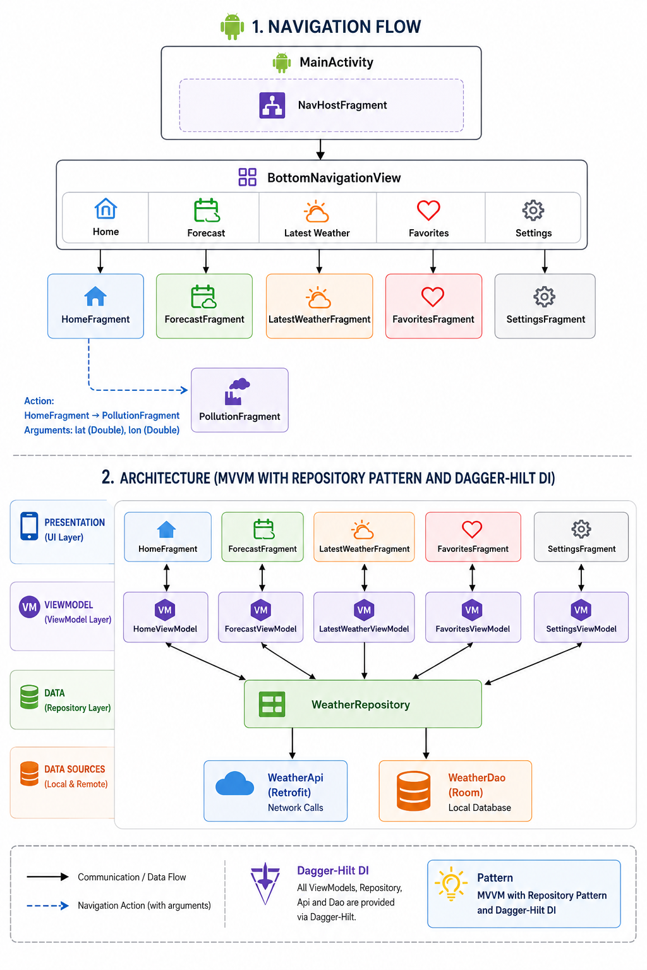
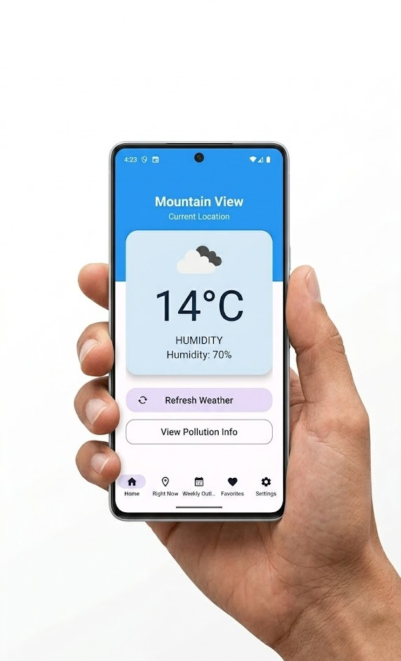


Android Application Development With Kotlin | Weather App Presented by: Liran Cordova, Or Zuka, Or Rodrigez Semester B 2026
Eran Katsav
1. Introduction
• Overview: This project presents a high-performance, reactive Android Weather Application built with Kotlin. The app provides real-time meteorological data, 5-day forecasts, and detailed Air Quality Index (AQI) reports.
• Purpose: To offer a clean, distraction-free tool for monitoring local weather, air quality, and saved favorite cities.
• Target Audience: General mobile users, frequent travelers, and health-conscious individuals who need reliable at-a-glance environmental information.
• Core Objective: Leverage modern Android standards to build an "Offline-First" app (Room database) that stays responsive via Coroutines and Flow.
2. Technical Architecture & Tech Stack
• Architecture: MVVM (Model-View-ViewModel) with clear separation between UI, ViewModels, Repository, and data sources.
• Dependency Injection: Dagger-Hilt manages object lifecycles for modular, testable code.
• Data Strategy: Repository Pattern as the "Single Source of Truth" between Retrofit (OpenWeatherMap API) and Room local persistence.
• Background Tasks: WorkManager performs periodic weather updates when the app is closed.
• External Libraries: Retrofit, Gson, Room, Dagger-Hilt, Glide, WorkManager, Jetpack Navigation, Material 3, Google Play Location Services.
• Key Methods: offline-first repository sync, ViewModel coroutine loading, GPS-based refresh, and background worker updates.
3. User Experience & Navigation Flow
• Diagrams (right): Application screen-flow chart and MVVM / Repository architecture UML-style diagram with navigation paths and screenshots.
• Navigation: Single-activity app using Jetpack Navigation Component and Material 3 bottom navigation.
• Key Modules: Home & Latest (GPS weather), Forecast, Pollution (AQI / PM2.5 / NO₂), Favorites (Room), and Settings.
• UI/UX: Material 3 design, ViewBinding, and reactive UI updates via LiveData / Flow.
4. Conclusions
• Achieved Goals: Robust weather tracking with synchronized remote API data and local Room storage.
• Results: Sub-second UI updates through reactive streams (LiveData / Flow).
• Comparison: Exceeds the initial simple-weather target with background workers, air-quality data, and persistent favorites.
Video
GitHub
5. Discussions
• Further Development: Home-screen widgets, severe-weather notifications, and interactive radar maps via Google Maps API.
• Demo Video: Scan the QR code in the Access section or watch on YouTube: https://www.youtube.com/watch?v=B0h5Y6Pb5s0
• Access:

